Slide 1
Information and Network Security Fundamentals

Slide 2
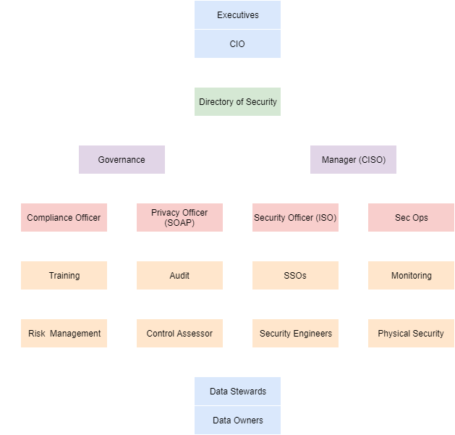
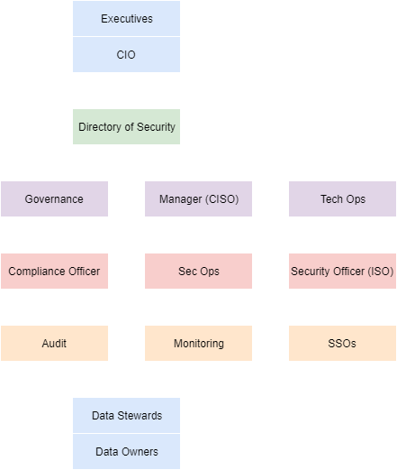
Typical hierarchy
Fortune 100 company
Fortune 500 company

Slide 3
Information Security Intro
If it’s valuable, someone will want it for their personal gain. It’s axiomatic to say that if the data is unprotected, it will be taken. Data is valuable. You can’t simply cross your fingers and hope that no one comes for it. Who protects the data?
The police?
Network/System admins?
Protecting data quickly became a specialized skill.
It also quickly became a full time job.
Information Security is often at odds with IT Operations. Ops seeks to maximize efficiency and uptime. Information Security often presents challenges that require solutions that countermand that mission.

Slide 4
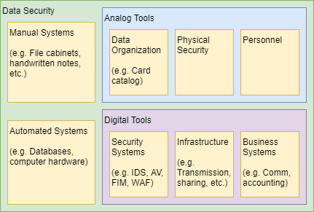
What is “Information”
Information security does not start and stop with computer systems.

Slide 5
The cost of a data breach
Cost 1: Monetary. PCI –“Fines can be up to $500,000 per occurrence” Fines per record ($150 - $200) doesn’t sound like much but consider: Michigan State University lost 300,000 student records.
Then restitution
Spending money on all those security systems you should have bought when they were first proposed!
Cost 2: Loss of Reputation
A Very Bad Thing™ happens
Guilt by association if an affiliated organization is breached
A supporter withdraws funding, citing bad press
Cost 3: Sanctions
A breach bring attention to security deficiencies that might be obligated by statute or contract. Failure to abide may result in legal issues or, as in the case of PCI, breach of contract and loss of services.

Slide 6
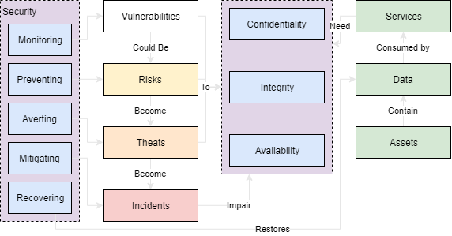

Slide 7
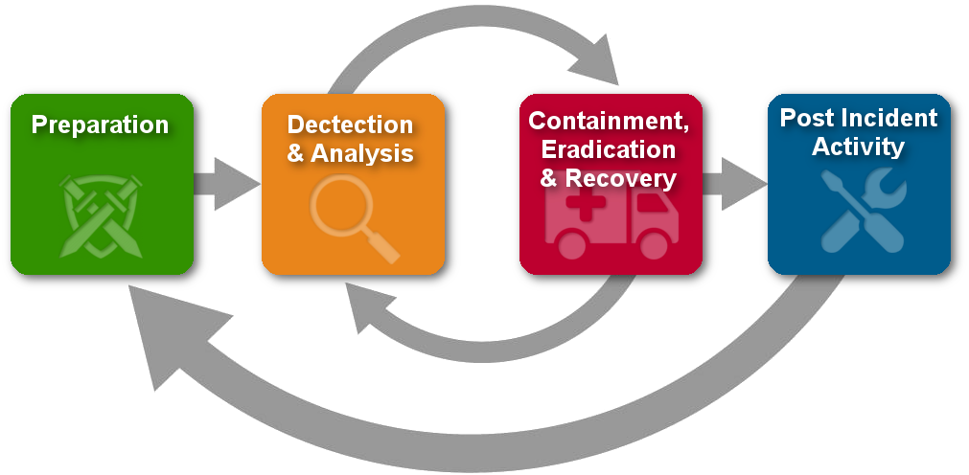
Security Cycle

Slide 8
The only secure computer…
“The only truly secure system is one that is powered off, cast in a block of concrete and sealed in a lead-lined room with armed guards - and even then I have my doubts.”
"Computer Recreations: Of Worms, Viruses and Core War" by A. K. Dewdney in Scientific American, March 1989, pp 110.
Information Security vs. Information Assurance

Slide 9
Saltzer & Schroeder – 10 Security Principles
Economy of mechanism – Simplicity in design and implementation of security measures.
Fail-safe defaults – Default configurations should be conservative in protection (within ethics.)
Complete mediation – Every access to a resource must be checked for compliance.
Open design – Security design should be made publicly available (conv. of security through obscurity.)
Separation of privilege – Multiple conditions should exist to access restricted resources.
Least privilege – Each program and user should operate with bare minimum privileges required.
Least common mechanisms – Sharing of resources among multiple users should be minimized.
Psychological acceptability – User interfaces should be well designed and intuitive.
Work factor – The cost of circumventing security should be judged against the resources of an attacker.
Compromise recording – Monitoring may be preferable to prevention.

Slide 10
If you learn nothing else from this course, learn these basic principles of data security. The vast majority of security issues and data breaches could be avoided entirely if everyone followed these guidelines:

Slide 11
Basic Principles of Information Security
TRUST YOUR MOM. ALL OTHERS PAY CASH.
Human beings are always the weak link in security. Plan for a failure of trust.
Zero-Trust not always an option, but the best case.

Slide 12
Basic Principles of Information Security
SECURE IN LAYERS.
Any organization that places all their security eggs in one basket is a sucker’s bet. “We don’t need anti-virus because attackers couldn’t get past our firewalls” and similar arguments are as common as colds. No security system is foolproof. Efficacy erodes over time. Efficacy erodes in the name of convenience or business needs. Plan for a failure of systems.

Slide 13
Basic Principles of Information Security
PATCH EARLY AND OFTEN.
Most failure-at-software attacks are due to known unpatched vulnerabilities. It’s a common complaint in IT Ops that patching takes time and causes downtime as patches cause unforeseen problems. That dog don’t hunt. You know what’s more inconvenient than downtime? Breaches. Also keep in mind that patching won’t protect you from everything. Zero-Day attacks are common. Plan for a failure of security.

Slide 14
Basic Principles of Information Security
YOU CAN’T WIN.
I’ve told you to plan for failure three times. It’s a common mistake to think that Information Security is about protecting data. It’s not. A dedicated attacker can hit an organization a thousand different ways and only have to succeed once to win. Security must succeed every single time. It’s not possible. Information Security is about managing risk and responding to threats. Even then, the best laid plans of mice and men often go awry. Plan. For. Failure.

Slide 15
Security Axioms:
Information security supports the mission of the organization.
Information security is an integral element of sound management.
Information security protections are implemented to be commensurate with risk.
Information security roles and responsibilities are made explicit.
Information security responsibilities for system owners go beyond their own organization.
Information security requires a comprehensive and integrated approach.
Information security is assessed and monitored regularly.
Information security is constrained by societal and cultural factors.

Slide 16
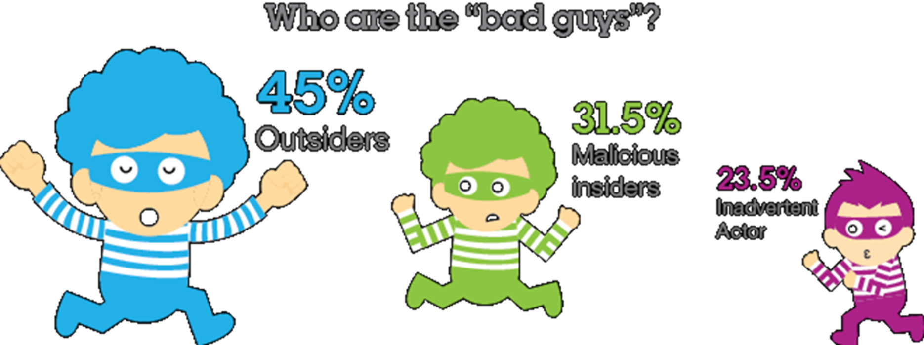
Where are the threats?
ADVERSARIAL
Individual
Outsider, Insider, Trusted Insider, Privileged Insider
Group
Ad hoc or established
Organization
Competitor, Supplier, Partner, Customer
Nation-State
NON-ADVERSARIAL
Accidental
Erroneous actions taken by individuals in the course of executing their everyday responsibilities.
Structural
Failures of equipment, environmental controls, or software
Environmental
Natural disasters and failures of critical infrastructures which are outside the control of the organization.

Slide 17

